Slide 1
Data Science and Machine Learning
Module 5, Lesson 3:
Spark ML Overview and Azure Spark

Slide 2
Topics
Spark ML: Estimators, Transformers and Pipelines
Spark Cluster on Azure HDInsight

Slide 3
Objectives
By the end of this lesson you should be able to:
Recognize the Spark ML API
Demonstrate how a Spark Cluster is configured on top of HDInsight Cluster
Explain some features available in Azure HDInsight Spark Clusters

Slide 4
Spark ML

Slide 5
Spark ML Overview
Spark’s second generation machine learning library platform
Built on top of Spark DataFrames to help users create and tune practical machine learning pipelines
Standardizes APIs to facilitate combination of multiple algorithms into a single pipeline or workflow
Pipeline concept mostly inspired by the scikit-learn project
Notes:
References:
https://spark.apache.org/docs/latest/ml-guide.html

Slide 6
Spark ML Main Concepts
Concept | Description
DataFrames | From Spark SQL as an ML dataset, DataFrames can hold a variety of data types. DataFrame columns can store text, feature vectors, true labels, predictions, etc
Transformer | An algorithm that can transform one DataFrame into another. A ML model is a transformer which transforms feature DataFrames into a predictions DataFrame
Estimator | An algorithm which can fit on a DataFrame to produce a Transformer. A learning algorithm, for example, is an Estimator which trains on a DataFrame to produce a model
Pipeline | Chains multiple Transformers and Estimators together to create ML workflow
Parameter | All Transformers and Estimators share a common API for specifying parameters
Notes:
References:
https://spark.apache.org/docs/latest/ml-guide.html

Slide 7
DataFrame
Supports a wide variety of data types
Machine learning is applied to data types, such as vectors, matrices, text, images, and structured data
DataFrame supports many basic structured data types as well as ML vectors
A DataFrame can be created implicitly or explicitly from a regular RDD
Notes:
Notes:
Columns in a DataFrame are named. For example, they can be “text”, “features”, and “truth label” .
Reference:
https://spark.apache.org/docs/latest/ml-guide.html

Slide 8
Transformers
Algorithm that can transfer one DataFrame into another
Transformers implement transform() method
Feature transformer
Learning model
Notes:
Notes:
The transform() method converts one DataFrame into another, generally by appending columns.
The feature transformer takes a DataFrame, reads a column (text), maps it into a new column (feature vector), and outputs a new DataFrame with the mapped column appended.
The learning model takes a DataFrame, reads the column containing the feature vectors, predicts a label for each feature vector, and outputs a new DataFrame with predicted labels appended.
Reference:
https://spark.apache.org/docs/latest/ml-guide.html

Slide 9
Estimators
Abstraction of algorithm that fits or trains on data
Estimators implement the fit() method
Example: A learning algorithm such as Logistic Regression is an Estimator, which calls fit() to train a Logistic Regression Model
Notes:
Notes:
The fit() method accepts a DataFrame and produces a model, which is a Transformer.
Reference:
https://spark.apache.org/docs/latest/ml-guide.html

Slide 10
Pipeline
Sequence of stages, either Transformer or Estimator
Stages are run in order and DataFrames are transformed as it passes through each stage
Transformer
Transformer
Estimator
Transformer
Tokenizer
HashingTF
Logistic Regression
LR Model
Raw Text
Words
Feature Vectors
LR Model
Notes:
Notes:
Graphics shows example of how DataFrame is converted at each stage.
Starts out as raw text dataframe to which tokenizer transformer is applied producing words.
HashingTF is applied to Words, producing Feature Vectors.
The Feature Vectors are fitted to a logistic regression estimator that finally produces a logistic regression model transformer
References:
https://spark.apache.org/docs/latest/ml-guide.html

Slide 11
Parameters
Uniform API is used to specify parameters for estimators and transformers
Param: A named parameter with self-contained documentation
ParamMap: A set of parameter, value pairs
Two main ways to pass parameters to an algorithm:
Set parameters for an instance – e.g., if lr is an instance, lr.setMaxIter(10) would make lr.fit() use at most 10 iterations
Pass a ParamMap to fit() or transform()
Notes:
References:
https://spark.apache.org/docs/latest/ml-guide.html

Slide 12
Spark on Azure

Slide 13
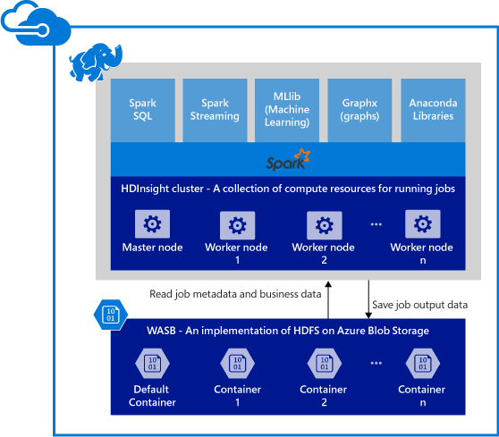
Spark on Azure
Azure compute resources with Spark installed and configured for a Spark cluster in HDInsight
Data to be processed is stored in Azure Blob storage
Notes:
References:
https://azure.microsoft.com/en-us/documentation/articles/hdinsight-apache-spark-overview/
Image Source: https://acom.azurecomcdn.net/80C57D/cdn/mediahandler/docarticles/dpsmedia-prod/azure.microsoft.com/en-us/documentation/articles/hdinsight-apache-spark-overview/20160603100044/hdispark.architecture.png

Slide 14
Azure Event Hub
Connector to Azure Event Hub to build streaming application
Azure Event Hub is an event processing service that provides a foundation for large-scale data intake in a broad variety of scenarios
Spark users on Azure can integrate their solutions with Azure Event Hub along with other services such as Kafka to build streaming applications
Notes:
Notes:
Scenarios include:
Behavior tracking in mobile apps
Game event capture in console games
Telemetry data collected from IoT
References:
https://azure.microsoft.com/en-us/documentation/articles/hdinsight-apache-spark-overview/
https://azure.microsoft.com/en-us/documentation/articles/event-hubs-overview/
http://kafka.apache.org/

Slide 15
Business Intelligence Tools
Connectors for popular BI tools for visualization of data
Connectors available for BI tools such as Power BI and Tableau for data analytics and visualization
Notes:
References:
https://azure.microsoft.com/en-us/documentation/articles/hdinsight-apache-spark-overview/

Slide 16
Anaconda Library
Libraries for machine learning, data analysis, visualization, etc
Anaconda is a free package manager, environment manager, Python distribution, and collection of over 720 open-source packages
Spark on Azure has Anaconda preinstalled
Notes:
References:
https://azure.microsoft.com/en-us/documentation/articles/hdinsight-apache-spark-overview/
https://docs.continuum.io/anaconda/index

Slide 17
Scalability Features
Spark HDInsight clusters can be grown or shrunk to fit need
Users can specify number of notes during cluster creation
Number of nodes in cluster can be increased or decreased after initial cluster creation to better fit current needs
Users can cache data either into memory or SSDs allowing them to tradeoff cost vs. performance
Clusters can be torn down without loss of data (since they are stored in Azure Blobs)
Notes:
Notes:
SSD = solid state device storage
References:
https://azure.microsoft.com/en-us/documentation/articles/hdinsight-apache-spark-overview/

Slide 18
Jupyter Notebook
Interactive data processing and visualization
Jupyter Notebook is a web application that allows users to create and share documents that contain live code, equations, visualizations and explanatory text
Jupyter supports many programming languages including those popular in data science and machine learning such as Python, Scala, R, and Julia
Notes:
Notes:
The URL to access Jupyter Notebook on Spark HDInsight clusters is https://CLUSTERNAME.azurehdinsight.net/jupyter.
Replace CLUSTERNAME with the name of organization’s Spark HDInsight cluster.
References:
https://azure.microsoft.com/en-us/documentation/articles/hdinsight-apache-spark-overview/
http://jupyter.org/

Slide 19
Summary
In this lesson, you have learned how to:
Recognize the Spark ML API
Demonstrate how a Spark Cluster is configured on top of HDInsight Cluster
Explain some features available in Azure HDInsight Spark Clusters
Notes:
Notes:
The Module 5 Lesson 3 lab should be completed at this time:
https://github.com/MSFTImagine/computerscience/tree/master/Complimentary%20Course%20Content/Module5/Labs

